Slide 1
ENSE 470 Milestone 1
Jeremy Cross
Iden Ellia
Abdullah Alasmari

Slide 2
Team name and Introductions

Slide 3
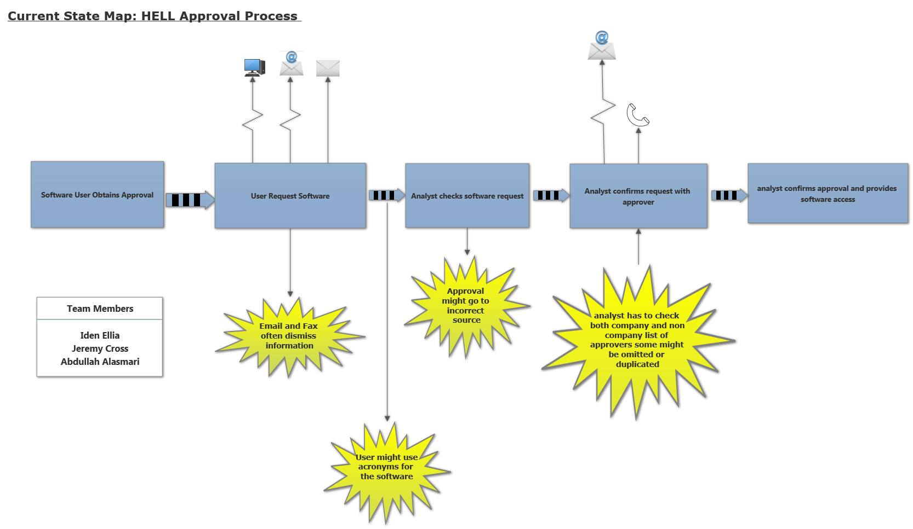
Current State Value Stream Map (VSM)

Slide 4
Other Information

Slide 5
Group Reflection
How did you feel about this milestone? What did you like about it? What did you dislike?
Its help us break down the problem and understand the individual steps required for the process
What did you learn about yourself as you collaborated and worked through this milestone?
How to remove water marks lolz
How will you use what you have learned going forward?
What “stuff & things” related to this milestone would you want help with?
[Response here]

